Slide 1
Diffraction phasing
for nano-crystals/particles
Research group on
Methods of Solving Crystal Structures
URL: http://cryst.iphy.ac.cn
Institute of Physics
Chinese Academy of Sciences
Beijing 100190, P.R. China

Slide 2
Two points are to be
emphasized in this talk
Diffraction phasing is still important in X-ray coherent diffraction imaging;
Combination of oversampling phasing [References: D. Sayre, Acta Cryst. 5, 843(1952); D. Sayre, H.N. Chapman & J. Miao, Acta Cryst. A54, 232-239 (1998)] and existent protein crystallographic phasing methods can do things better than either of them alone.

Slide 3
The dual-space phasing framework
|Fo|exp(iϕ’) ⇒ ρ (r)
Reciprocal space：
Replacing |Fc| with |Fo|
and modifying ϕ
Real space：
modifying ρ (r)
|Fc|exp(iϕ) ⇐ ρ’ (r)
Notes:
3

Slide 4
Gerchberg, R.W. & Saxton, W.O. Optik, 34, 275-284 (1971)；35,
237-246 (1972)
Wang, B.C. Methods in Enzymology 115, 90-112 (1985)
Density modification by solvent flattening
Weeks, C.M., Detita, G.T., Miller, R. & Hauptman, H.A.
Acta Cryst. D49, 179-181 (1993)
Ab initio dual-space direct method phasing (Shake & Bake)
Sheldrick, G.M. & Gould, R.O. Acta Cryst. B51, 423-431 (1995)
Iterative peaklist optimization and tangent expansion (ShelxD)
Foadi, J., Woolfson, M.M., Dodson, E.J., Wilson, K.S., Yao, J.X. & Zheng, C.D.
Acta Cryst. D56, 1137-1147 (2000)
Acorn
Miao, J., Hodgson, K.O. & Sayre, D. PNAS, 98, 6641-6645 (2001)
Oversampling phasing
Wang, J.W., Chen, J. R., Gu, Y. X., Zheng, C. D. & Fan, H. F.
Acta Cryst. D60, 1991–1996 (2004)
Iterative dual-space direct-method SAD/SIR phasing
He, Y., Yao, D.Q., Gu, Y.X., Lin, Z.J., Zheng, C.D. & Fan, H.F.
Acta Cryst. D63, 793–799 (2007)
Iterative dual-space direct-method model completion
Notes:
4

Slide 5
The efficiency of a particular iterative dual-space phasing process depends on
what constraints are set in the real and the reciprocal space.

Slide 6
The trial and error method in crystallography
A structure model is built at the beginning with the constraints of the known chemical information, crystal symmetry and unit cell dimensions. Then in the following cycles the model is adjusted according
to the ρ(r) from the previous cycle.
|Fo|exp(iϕ) ⇒ ρ (r)
Reciprocal space：
replacing |Fc| with |Fo|
no modification to ϕ
Real space：
modifying ρ(r)
This method is capable of solving structures containing ~10 atoms in the ASU.
|Fc|exp(iϕ) ⇐ ρ’ (r)
Notes:
6

Slide 7
The Patterson method
|Fo|exp(iϕ) ⇒ ρ (r)
A structure model is built at the beginning according to the experimental Patterson function. Then in the following cycles the model is adjusted according to the ρ(r) from the previous cycle.
Reciprocal space：
replacing |Fc| with |Fo|
no modification to ϕ
Real space：
modifying ρ(r)
This method is capable of solving structures containing ~100 atoms in the ASU, when there are ‘heavy atoms’ in the crystal; or it is capable of solving structures containing ~20 atoms in the ASU when there are no ‘heavy atoms’ in the crystal.
|Fc|exp(iϕ) ⇐ ρ’ (r)
Notes:
7

Slide 8
Direct methods
|Fo|exp(iϕ) ⇒ ρ (r)
Structure models are built according to the direct-method phased E-map from the previous cycle.
Phases are derived directly based on the Sayre equation (1952) or the tangent formula (Karle & Hauptman, 1956).
Reciprocal space：
replacing |Fc| with |Fo|
and modifying ϕ
Real space：
modifying ρ(r)
This kind of methods is capable of solving structures containing ~1000 atoms in the ASU.
|Fc|exp(iϕ) ⇐ ρ’ (r)
Notes:
8

Slide 9
Traditional protein crystallographic methods − MIR/SIR, MAD/SAD MR and density-modification techniques
|Fo|exp(iϕ) ⇒ ρ (r)
Additional experimental data or known structure of similar proteins are used to set constraints in real and/or reciprocal space.
Reciprocal space：
replacing |Fc| with |Fo|
and modifying ϕ
Real space：
modifying ρ(r)
This kind of methods is capable of solving structures containing ~100,000 atoms in the ASU.
|Fc|exp(iϕ) ⇐ ρ’ (r)
Notes:
9

Slide 10
Adding some constraints in either
real or reciprocal space leads to a
chance of improvement.

Slide 11
Oversampling Phasing
Reference: J. Miao, K.O. Hodgson & D. Sayre,
PNAS, 98, 6641-6645 (2001)
Possible improvement:
Combining oversampling with direct methods − for high resolution data (better than ~ 4.0Å) direct methods can provide strong reciprocal-space constraints.
|Fo|exp(iϕ) ⇒ ρ (r)
Reciprocal space：
replacing |Fc| with |Fo|
no modification to ϕ
Real space：
modifying ρ(r)
Two constraints are applied:
1. outside the finite support: ρ(r) = 0
2. within the finite support: ρ(r) ≥ 0
|Fc|exp(iϕ) ⇐ ρ’ (r)
Notes:
11

Slide 12
Direct Methods in Protein Crystallography
Ab initio direct methods:
Saytan (M.M. Woolfson’s team, 1988 ~)
SnB (H.A. Hauptman’s team, 1993 ~)
ShelxD (G.M. Sheldrick’s team, 1994 ~)
Acorn (M.M. Woolfson’s team, 2000 ~)
Direct-method phase extension/refinement:
(Combining direct methods with other protein phasing methods)
Fan, H.F. Acta Phys. Sin. 21, 1114-1118 (1965)
Sayre, D. Acta Cryst. A28, 210-212 (1972)
Hauptman, H.A. Acta Cryst. A38, 632-641 ; 289-294 (1982)
Giacovazzo, C. Acta Cryst. A39, 585-592 (1983)
Oasis (IoP, CAS, 1984 ~)

Slide 13
What can be done
by OASIS ?
Phase extension based on a partial structure
Dual-space SAD/SIR Iteration
Dual-space MR Iteration
Case 1. SAD/SIR information available
Case 2. SAD/SIR information NOT available

Slide 14
Dual-space SAD/SIR iteration
SAD/SIR
data
Direct-method phasing by OASIS
Partial structure
Density modification by DM
Model building by ARP/wARP – RefMac or Buccaneer – RefMac
Satisfied ?
No
End
Yes
Acta Cryst. D60, 1991-1996 (2004)
Acta Cryst. D62, 883-890 (2006)

Slide 15
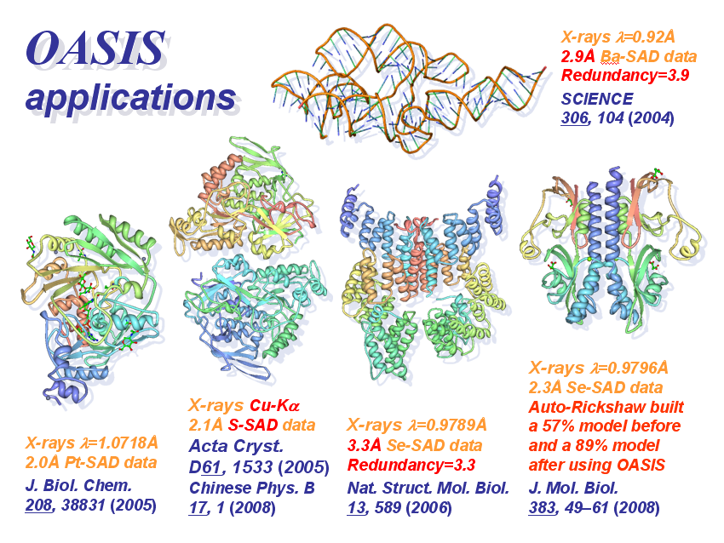
SAD phasing/
iteration

Slide 16
Breaking the SAD phase ambiguity
TT0570 (2d5w) sulfur-SAD CuKα data, redundancy = 26.1
(1206 resides in the AU, Bijvoet ratio = 0.55%)
Programs used: Oasis, DM, FFT program in CCP4 and PyMOL
Chinese Physics B 17, 1-9 (2008)
Notes:
16

Slide 17
Dual-space MR iteration
MR
model
Direct-method phasing by OASIS
Density modification by DM
Model building by ARP/wARP – RefMac or Buccaneer – RefMac
Satisfied ?
No
End
Yes
Acta Cryst. D63, 793-799 (2007)

Slide 18
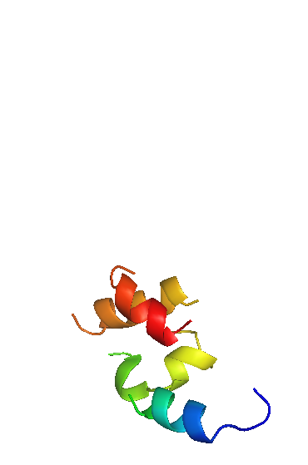
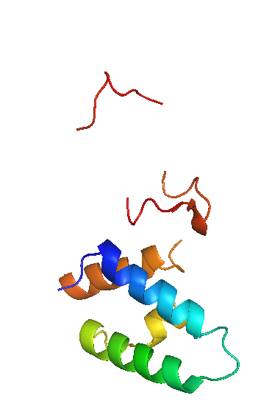
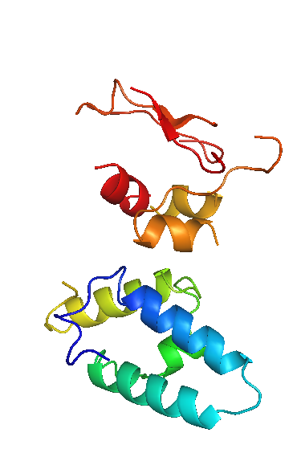
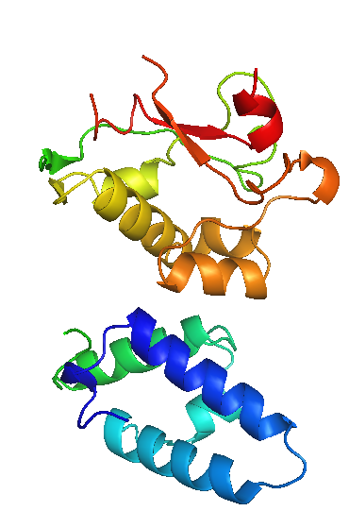
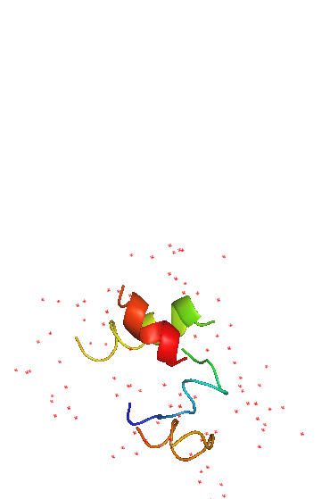
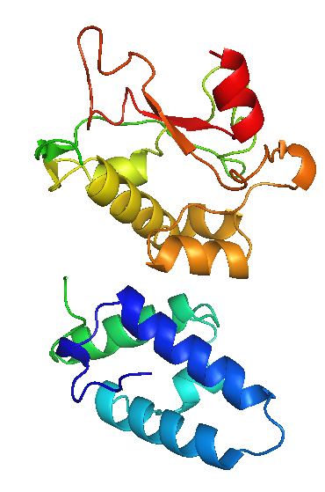
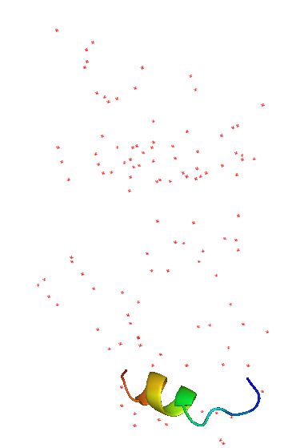
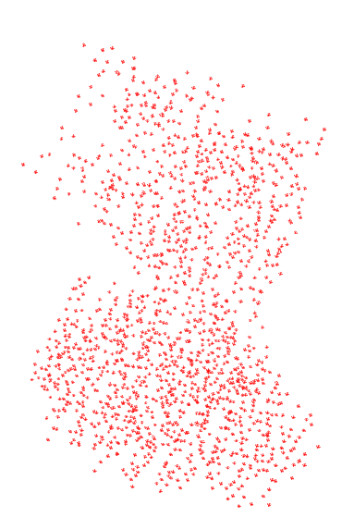
MR-model completion with E7_C–Im7_C data (1ujz)
OASIS-DM-ARP/wARP iteration
E7_C–Im7_C
Cycle 1
Cycle 3
Cycle 5
Cycle 7
201 residues
all with side chains
MR
model
Final
model
46 residues
13 with side chains
215 residues
ARP/wARP-DM
iteration
Cycle 1
Cycle 2
Notes:
18
图中所示为蛋白质复合物E7_C–Im7_C的MR模型迭代过程。左边是由分子置换(MR)法求得的部分结构模型；右边是经过精修之后的“最终”模型。从MR模型出发用ARP/wARP-DM迭代，所得结构模型逐轮退化如图底部所示。及至第三轮还出现运行错误。但是，在ARP/wARP和DM之间加入OASIS-2006，则可以自动构建出相当于整体结构90%以上的结构模型，如图上部所示。

Slide 19
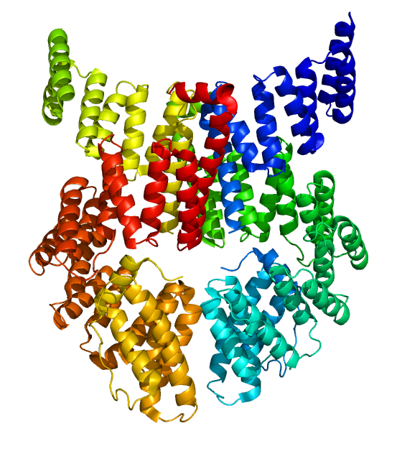
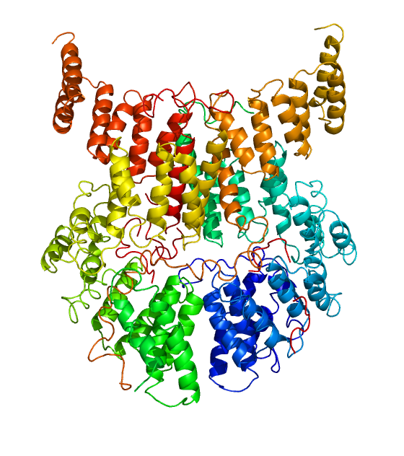
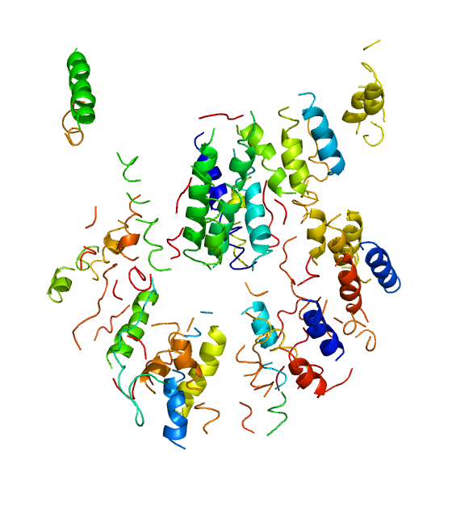
MR iteration based on a SAD model
Tom70p (2gw1) 3.3Å Se-SAD data, redundancy = 3.3
Final
1086 residues
in the AU
MR iteration
Oasis - DM -
Buccaneer - Refmac
Model resulting from
SAD phasing by
PHINEX
Residues build | 1074 | 906
Residues sequenced | 1017 | 207
R / R _{free} | 0.285 / 0.403 | 0.48 / 0.59
Notes:
19

Slide 20
It is expected that, combination of the
oversampling phasing and direct-method
phasing will lead to better results than
that from either of them alone.

Slide 21
Thank you!

Slide 22
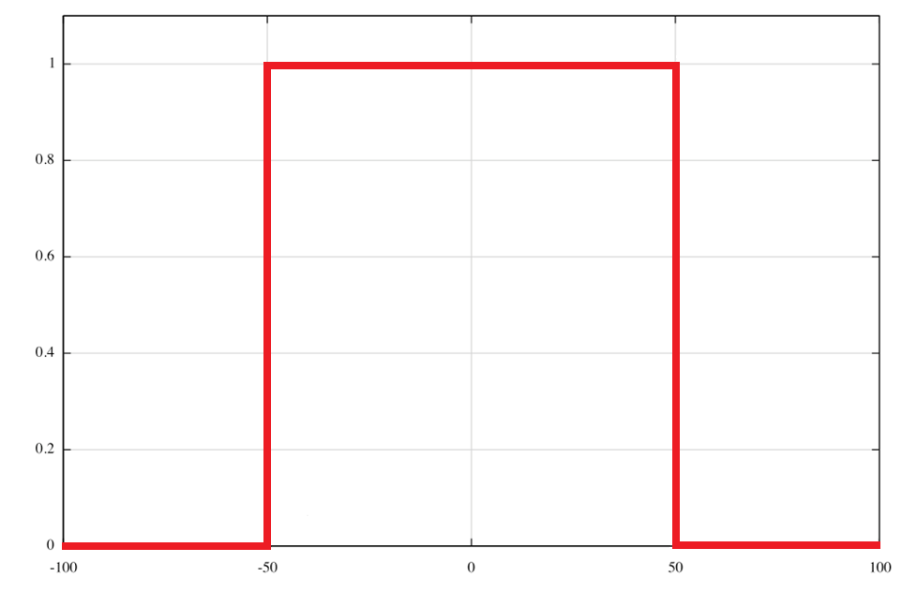
ρ (r)
1
0
-100
-50
0
50
100 Å

Slide 23
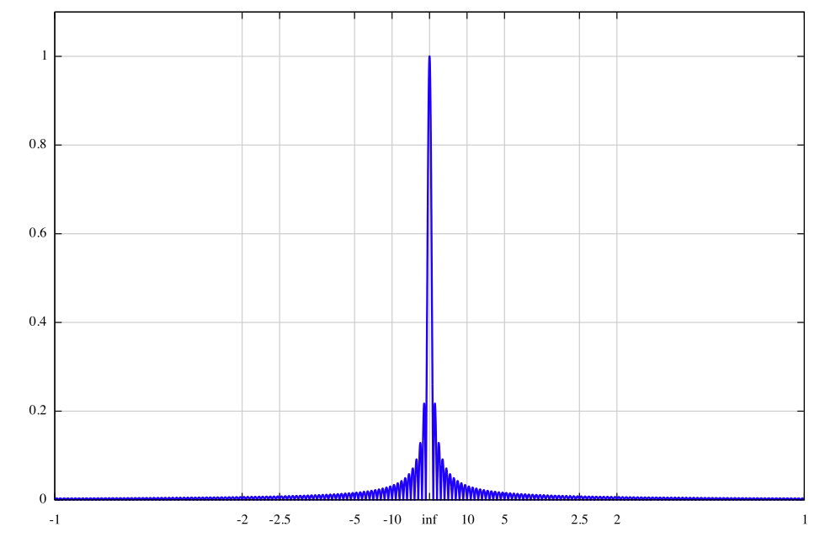
k |F (h)|
1
0
-1
-2
-5
∞
5
2
1 Å⁻¹

Slide 24
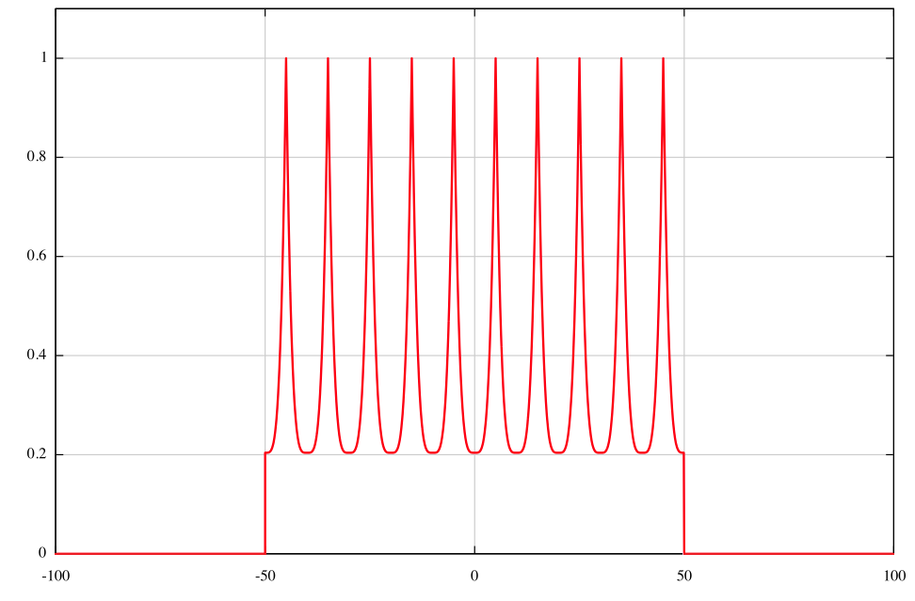
ρ (r)
1
0
-100
-50
0
50
100 Å

Slide 25
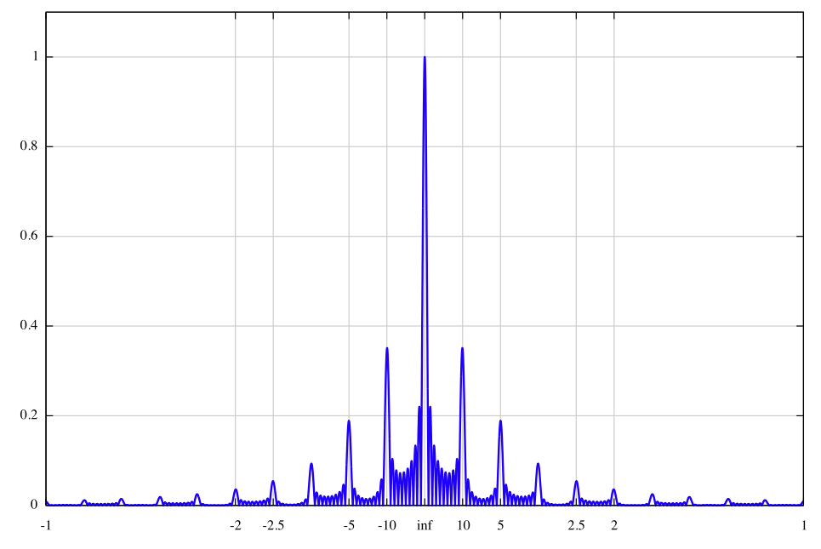
k |F (h)|
1
0
-1
-2
-5
∞
5
2
1 Å⁻¹

