Slide 1
OASIS-IPCAS
with emphasis on a new application of
MR model completion
Hao, Q., Zhang, H.M. (HKU)
& Zhang, T. Gu, Y.X. & Fan, H.F.*
(Inst. Phys., CAS)

Slide 2
OASIS & IPCAS
Zhang, T., He, Y., Wang, J.W., Wu, L.J., Zheng, C.D.,
Hao, Q., Gu, Y.X. and Fan, H.F. (2012)
Institute of Physics, Chinese Academy of Sciences
Beijing, P. R. China

Slide 3
OASIS (One-wavelength Anomalous scattering or Single Isomorphous Substitution)
A direct-method phase extension/refinement program based on a partial structure, which can be just the heavy-atom sub-structure or it can be from fragments to a nearly complete model
SAD/SIR information will be beneficial but not compulsory
IPCAS (Iterative Protein Crystal-structure Automatic Solution )
A pipeline from reflection files (*.sca or *.mtz) to a structure model (*.pdb and *.mtz)
Phasing: OASIS, ShelxC/D/E, PHASER
Density modification: DM, RESOLVE
Model building/refinement: ARP/wARP, PHENIX.AutoBuild, Buccaneer

Slide 4
Direct Methods in Protein Crystallography
Ab initio direct methods:
SAYTAN (M.M. Woolfson’s team, 1988 ~)
SnB (H.A. Hauptman’s team, 1993 ~)
SHELXD (G.M. Sheldrick’s team, 1994 ~)
ACORN (M.M. Woolfson’s team, 2000 ~)
Direct-method phase extension/refinement:
(Combining direct methods with other protein phasing methods)
Fan, H.F. Acta Phys. Sin. 21, 1114-1118 (1965)
Sayre, D. Acta Cryst. A28, 210-212 (1972)
Hauptman, H.A. Acta Cryst. A38, 632-641; 289-294 (1982)
Giacovazzo, C. Acta Cryst. A39, 585-592 (1983)
Fan, H.F. & Gu, Y.X. Acta Cryst. A41, 280-284 (1985)
OASIS Hao, Q., Gu, Y.X., Zheng, C.D. & Fan, H.F.
J. Appl. Cryst. 33, 980-981 (2000)

Slide 5
Features of OASIS-IPCAS
• SAD/SIR iteration
Iterative phasing/model building based on the heavy-atom substructure bearing SAD/SIR information
• MR iteration
Iterative phasing/model building based on a structure model, which can be from fragments to a nearly complete model without SAD/SIR information
• Phase extension
Iterative phasing/model building based on a subset of known phases

Slide 6
SAD data
‘SAD iteration’ in IPCAS
Partial structure
Direct-method SAD phasing
OASIS
Density modification
DM
RESOLVE
Model building
and refinement
AutoBuild (Phenix)
ARP/wARP/RefMac
Buccaneer/RefMac
Ok?
No
Yes
Acta Cryst. D60, 1991-1996 (2004)
Acta Cryst. D62, 883-890 (2006)
End

Slide 7
Direct-method SAD phasing
Phase information available in SAD given
the known heavy-atom substructure
1
3
2
Bimodal distribution
from SAD
Cochran
distribution
Sim
distribution
Peaked at
Peaked at
any where
from 0 to 2π
Some SAD phasing processes (e.g. Hendrickson & Teeter, Nature, 1981; Wang, Methods in Enzymology, 1985) make use of two of the three available distributions. We use all of them.
The phase of
F”

Slide 8
Direct-method SAD phasing
Bimodal
SAD distribution
Cochran distribution combined with
bimodal SAD distribution
Sim
distribution
Acta Cryst. A41, 280-284 (1985)

Slide 9
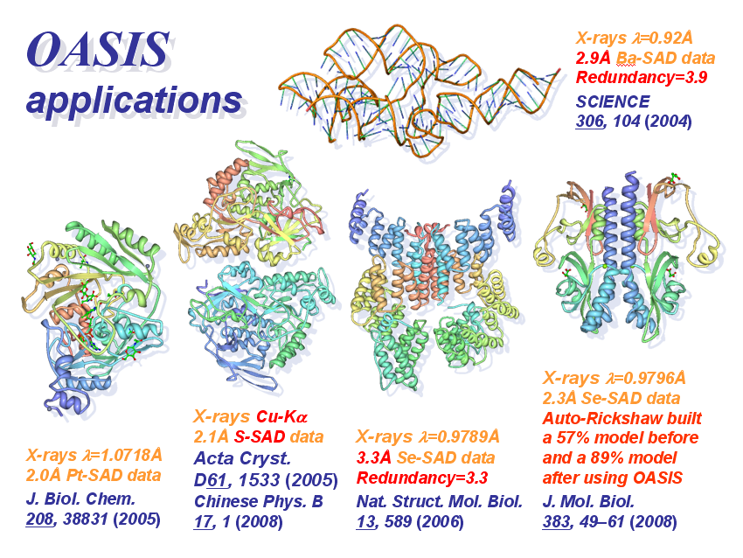
SAD phasing/
iteration

Slide 10
‘MR iteration’ in IPCAS
Partial structure
Direct method phase refinement
OASIS
Density modification
DM
RESOLVE
Model building
and refinement
AutoBuild (Phenix)
ARP/wARP/RefMac
Buccaneer/RefMac
Ok?
No
Yes
End

Slide 11
Phasing part of ‘MR iteration’
ϕ”_{h} is a set of ‘reference phases’ calculated each cycle from randomly selected 5% of the current structure model;
|Δϕ_{h}| is defined as the absolute difference between the current phase and ϕ”_{h}
Partial structure
Acta Cryst. D63, 793-799 (2007)

Slide 12
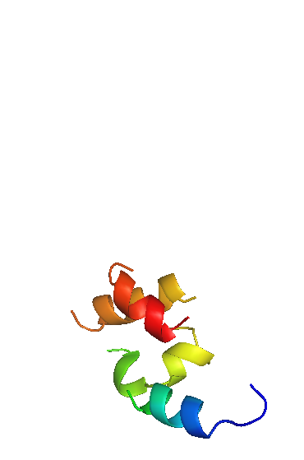
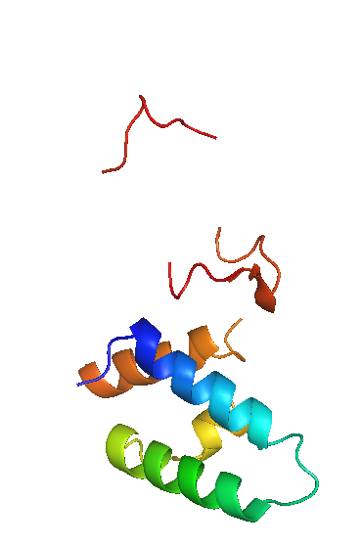
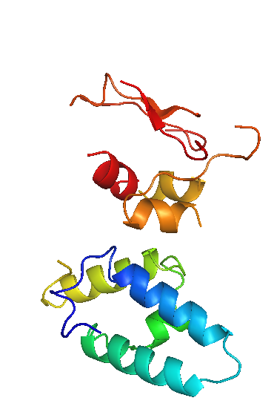
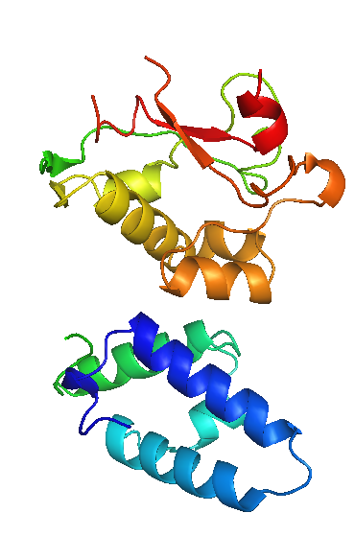
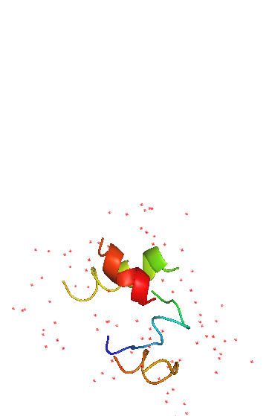
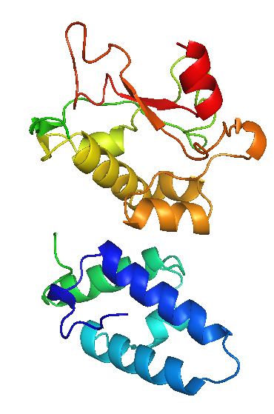
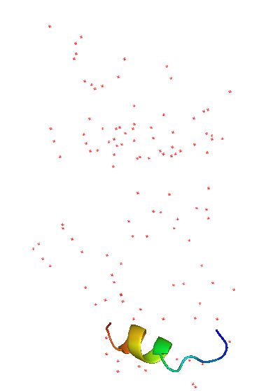
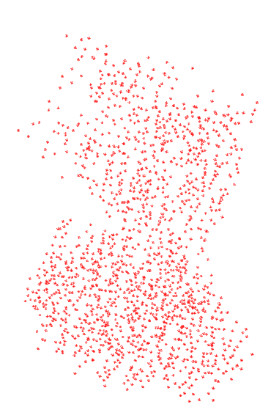
MR-model completion with E7_C–Im7_C data (1ujz)
OASIS-DM-ARP/wARP iteration
E7_C–Im7_C
Cycle 1
Cycle 3
Cycle 5
Cycle 7
201 residues
all with side chains
MR
model
Final
model
46 residues
13 with side chains
215 residues
ARP/wARP-DM
iteration
Cycle 1
Cycle 2
Notes:
12
图中所示为蛋白质复合物E7_C–Im7_C的MR模型迭代过程。左边是由分子置换(MR)法求得的部分结构模型；右边是经过精修之后的“最终”模型。从MR模型出发用ARP/wARP-DM迭代，所得结构模型逐轮退化如图底部所示。及至第三轮还出现运行错误。但是，在ARP/wARP和DM之间加入OASIS-2006，则可以自动构建出相当于整体结构90%以上的结构模型，如图上部所示。

Slide 13
Direct-method phase extension
As defined in
MR iteration
Input known phases to be kept fixed until the resultant model becomes big enough
Phenix.Autobuild
running with ‘quick’ and ‘helixes & strands only’
Initial model

Slide 14
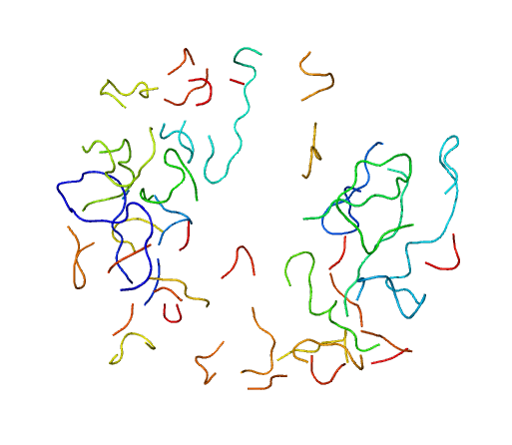
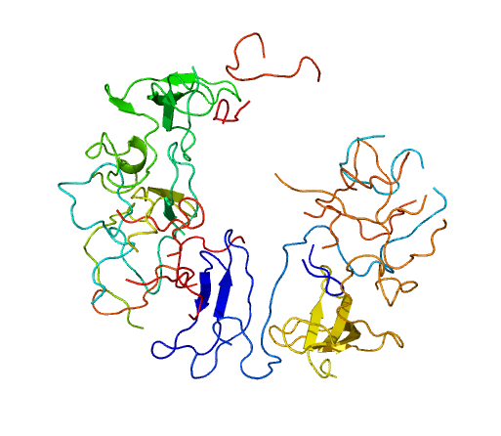
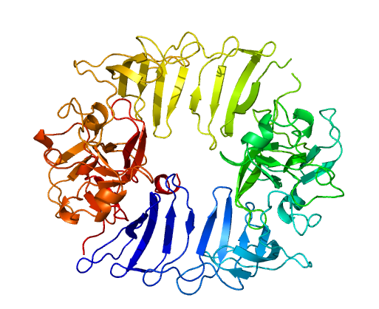
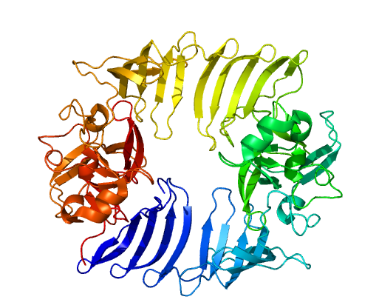
An example of direct-method phase extension
Starting with 4.5Å known
phases and
2.8Å F_{obs}
AutoBuild quick +
20 cycles of
DM-Buccaneer
iteration
AutoBuild quick +
20 cycles of
Oasis-DM-Buccaneer
iteration
1h3i Phase extension from 4.5 to 2.8Å
Final
model

Slide 15
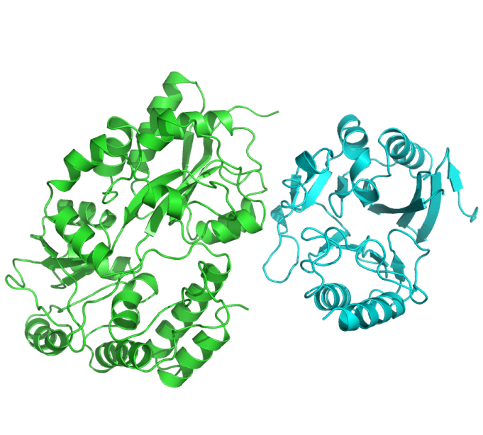
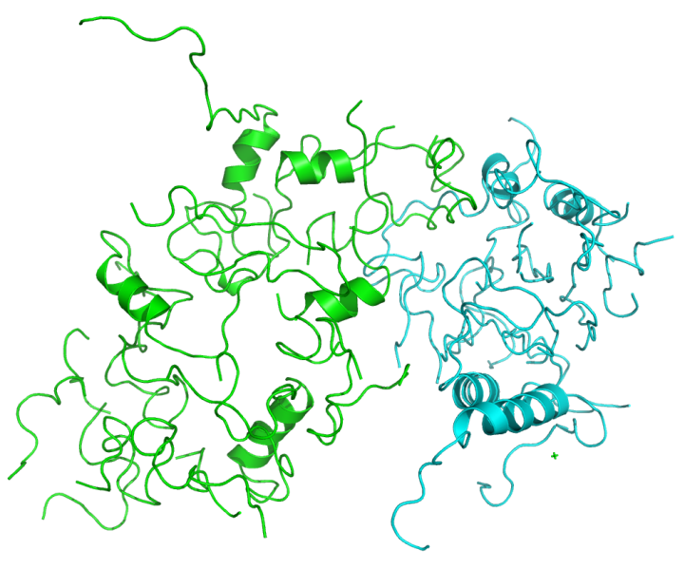
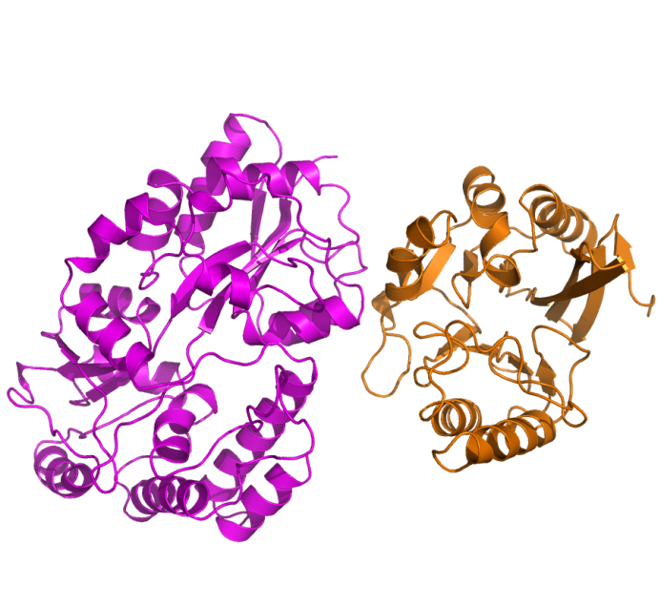
A latest application of MR model completion
MBP-NDM1 Data (2.25Å resolution) was used
(Zhang and Hao, The FASEB Journal, 2011)
Target structure
Without OASIS
With OASIS

Slide 16
Acknowledgements
This work is supported by the 973 Project (Grant No. 2011CB911101) of the Ministry of Science and Technology of China
&
GRF grant 765909M from the Research Grant Council of Hong Kong

